Slide 1
Underwriting Variable and Rental Income
Presented by Kim Grimes and Mike George

Slide 2
Goals of this training
1- Importance of establishing a complete story or timeline of Employment/Income
2- Understanding the difference in Fixed vs Variable Income and how to compute what income to use
3- Helpful Tips to review fixed/variable income documentation
4- Identify key elements on Rental Income
5- Help you discover and resolve issues up front

Slide 3
Importance of establishing a complete story or timeline of employment
Reviewing a loan application, Paychecks and W2
-Review loan application for a full 2-year work history
-Review WVOE, paystubs and W2 to see if it matches the loan application. If no VOE, does the information on the paystub and W2 support the timelines on the loan application
-If the paycheck shows an hourly rate of pay, greater scrutiny must be shown by comparing the year-to-date earnings vs full time (40 hours per week). Does YTD match what a 40-hour work week would be? Is prior year 2 years W2 income comparable to what we are trying to use
-If there are discrepancies, address up front.

Slide 4
Fixed VS Variable Incomes
Fixed Income
Variable income
Fixed income is stable, predictable and likely to continue with a predetermined amount that occurs with regular frequency and has a defined documentable term
Variable hourly income changes from each pay period and must be reviewed historically.

Slide 5
Variable Hourly Base Income
Additional documentation maybe required to clarify any discrepancies and inconsistencies with overall earnings/wages. If it is apparent that hours vary, then a historical average must be considered. HUD’s Guidance if hourly employee. The Mortgagee must average the income over the previous two years. If the Mortgagee can document an increase in pay rate the Mortgagee may use the most recent 12-month average of hours at the current pay rate.

Slide 6
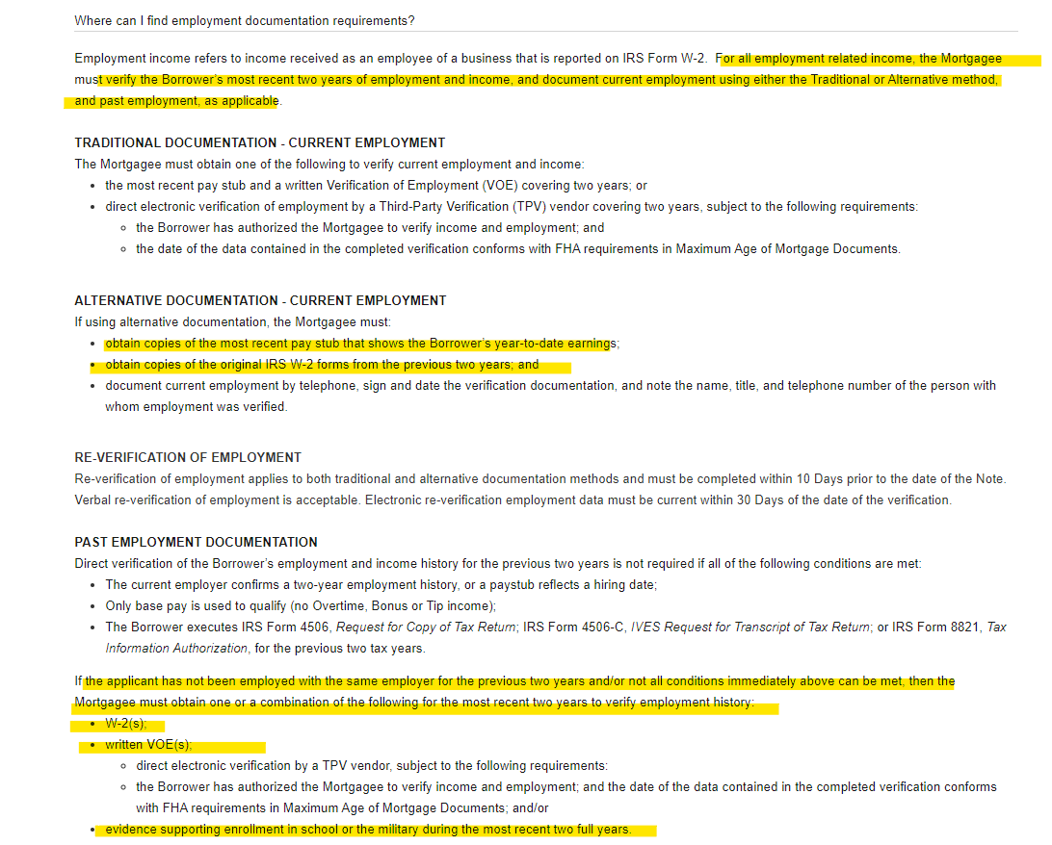

Slide 8
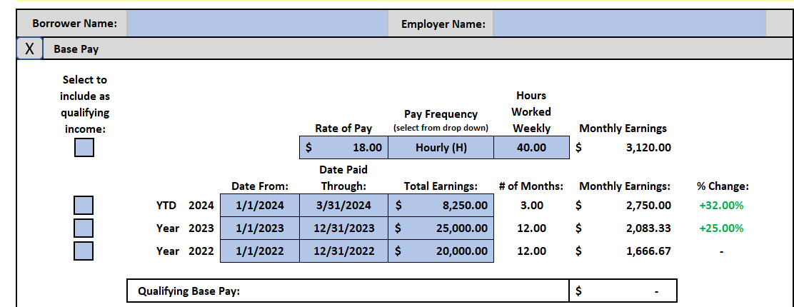
How to look at income
1- Review loan application for current and prior employment
2- review VOE and paystub to determine how the borrower is paid and calculate a year-to-date average
3- review W2 to see a history of income.
4- If there are any discrepancies, can they be documented and explained
Potential solutions for any discrepancies
1- get number of hours worked in 2023 and YTD (if same employer and use current rate of pay)
2- Was the borrower in school or working parttime, were they off work for a period. Something to JUSTIFY using a higher income
3- Union employees. Frequent raises so obtain the number of hours worked from the union hall and use current rate of pay

Slide 9
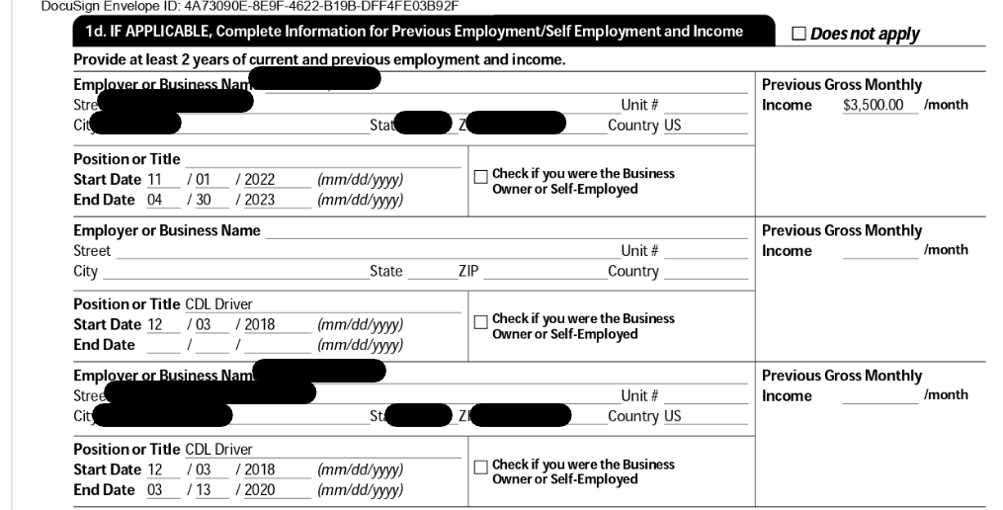

Slide 10
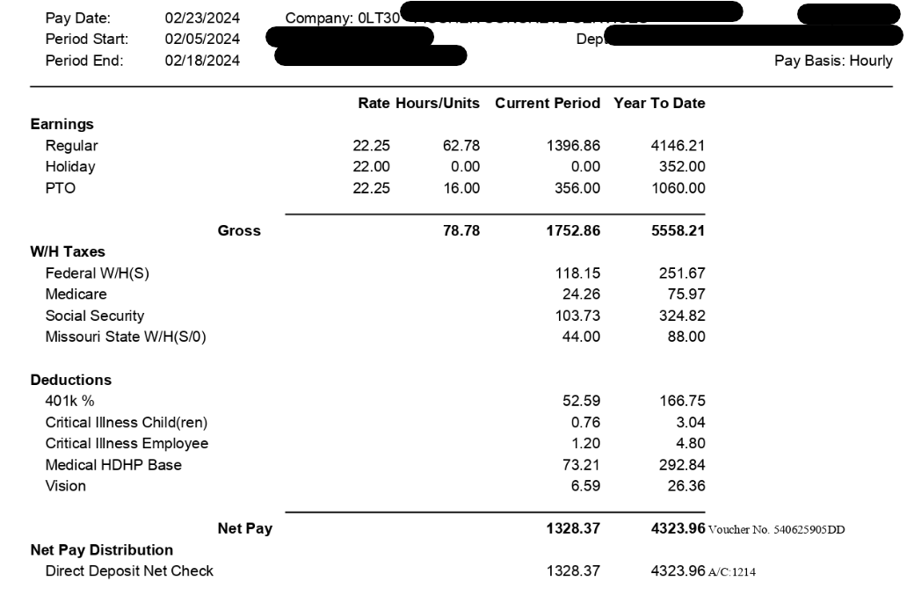

Slide 11
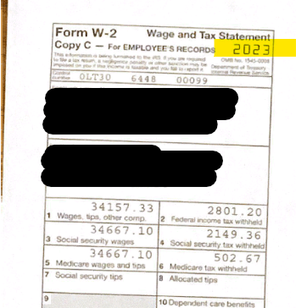
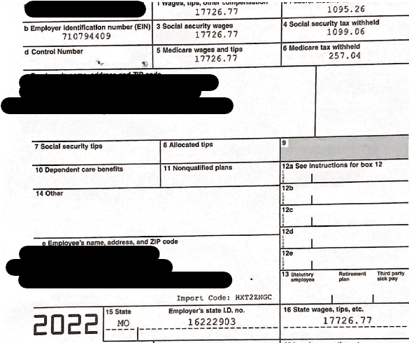
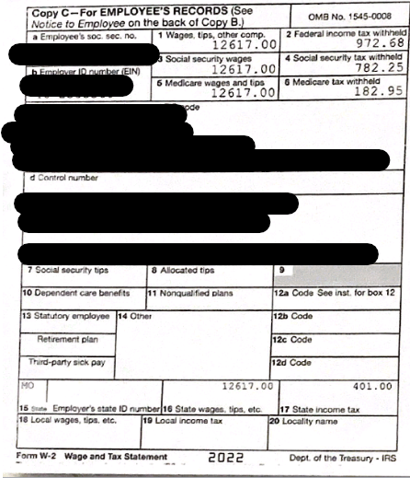
Current employer for 9.62 months
How can we justify using a shorter average? Obtain full VOE with hourly rates showing increasing and a letter of explanation

Slide 12
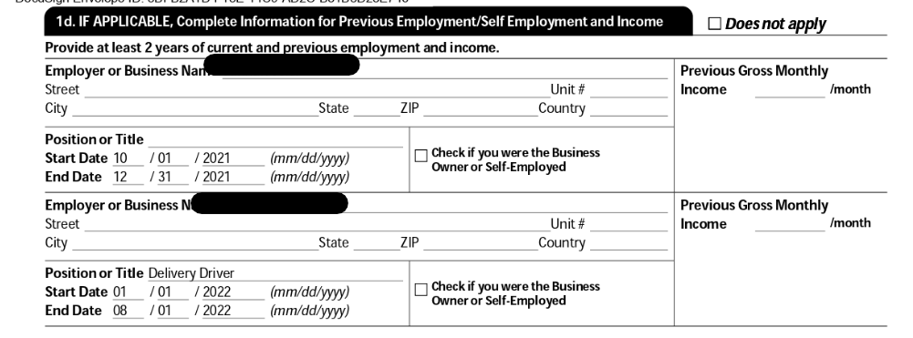

Slide 13
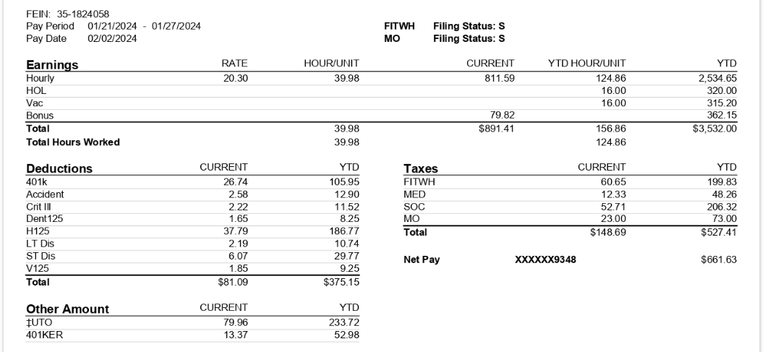

Slide 14
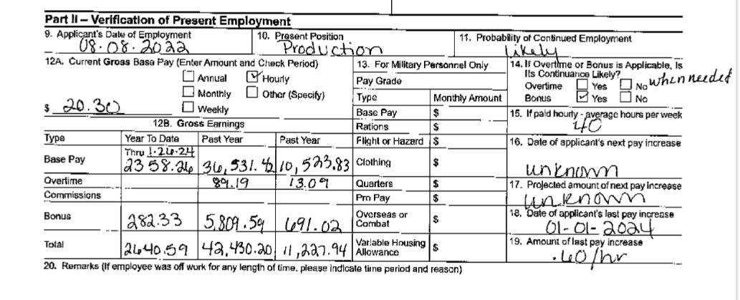

Slide 15
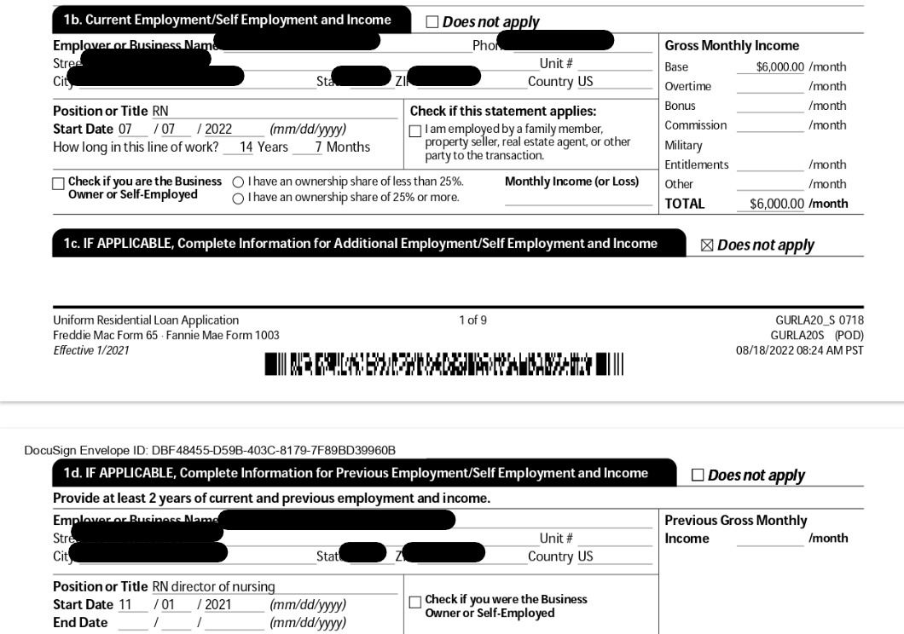
Loan Closed September of 2022
1- document income prior to July 7
2 W2 for 2021 and 2020

Slide 16
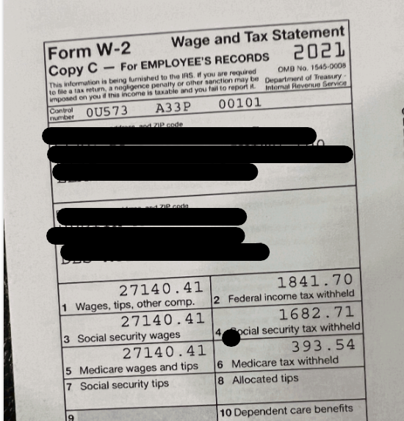
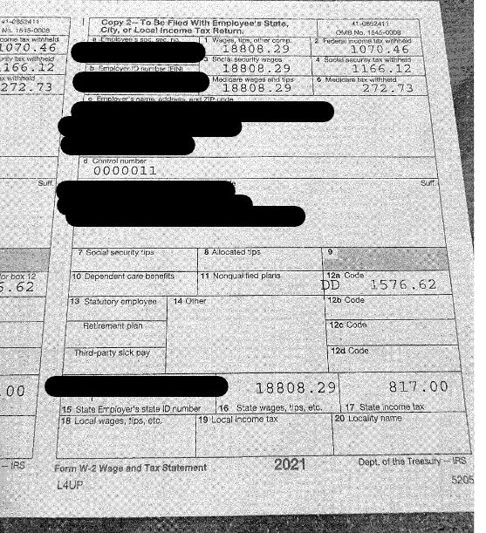
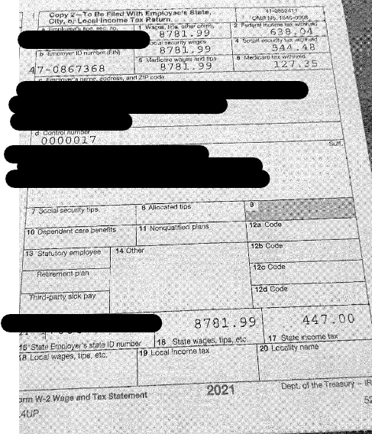
1- Question if income is stable and likely to continue
2 need employment letter and document why all the job changes
3- Per AUS “ if the borrower has changed jobs more than three times in the previous 12-month period, or has changed lines of work, verify and document the stability of the income. Obtain either transcripts of training and education or continued increases in income or benefits

Slide 17
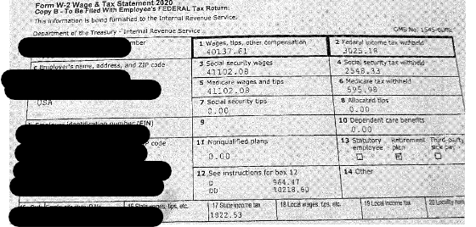
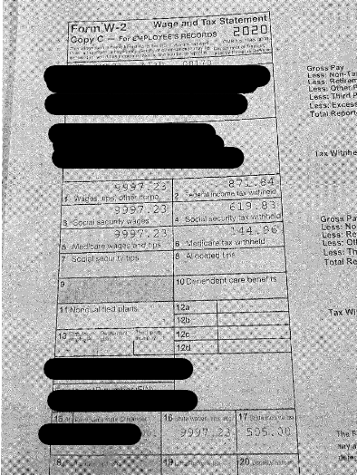
1- Add income per W2 for 2020 and 2021. Is that in line with YTD. Can we average the income earned

Slide 18
Variable income (Fluctuating earnings overtime, bonus and commission)
Variable income can be riskier because you don’t know what you’re going to see in the future and that is why you must look at it from a historic perspective
1- VOE is required (Year end paystubs for applicable years may also satisfy the requirement.
2- Is income consistent, increasing or decreasing? If decreasing may need LOX on why to determine if stable and likely to continue
3- Consider using a 24-month average, unless you can justify 12–24-month average OR you use the lowest/most conservative average
4-Input this variable income correctly on the 1003, so that AUS can layer the risk and provide accurate findings
5- Payment types that indicate reimbursement (per diem) or fringe benefits are NOT acceptable as income

Slide 19
Conventional Variable base hourly income
Like FHA. In some instances, for employment history, conventional loans may be more lenient. No Gap of employment requirements
- 12 months minimum employment history for fluctuating hourly earnings.

Slide 20
Why can’t income be the same computation for every loan and every loan type?
Risk varies on every single loan.
Not all loans are the same and we must review credit, capacity, capital, and collateral.

Slide 21
Rental Income
-Rental Income must be documented, meet specific qualifying requirements, and be established as a stable income source that is likely to continue.
- Rental income will depend on what type of loan you are doing and if there is a history of rental income.

Slide 22
VA Rental Income
03
2-4 Unit Property as subject (purchase)
6 months reserves
Veteran needs a prior history of managing property to use rental income.
Use 75% of the lease for the other units
01
Departing Residence
Offset Current PITIA with a copy of a Lease Agreement
Rental Properties the veteran currently owns
- 3 months cash reserves for each rental property used as income
2 years tax returns showing rental income
02

Slide 23
FHA Loan
Departing residence
Borrower must be moving 100 miles from subject property
25% equity is required on departing residence (full appraisal)
Need lease for term of at least 1 year after date of closing
Document Security Deposit and 1st month rent
Use the lessor of 75% of lease or the appraiser’s market rent

Slide 24
FHA Rental Income
-Rental Income the borrower currently owns
2 years of tax returns. If less than 2 years, document purchase with CD
COVID overlays still in place, reduce income by 25% or have 6 months PITIA in reserves OR 2 bank statements showing rental payments
Purchasing a 2-4 unit property
Use the appraiser's market rent at 75% for rental income
Self Sufficiency for 3–4-unit property-Rent from all units must cover the new PITIA payment

Slide 25
Conventional Rental Income
Departing Residence
Executed lease at 75% can be used only to offset current PITIA unless the borrower has a history of rental properties for 1 year then there is no limit on the rental income used.
Need proof of security deposit and 1 month rent or Form 1007 (Freddie Mac LPA doesn’t accept the Form 1007)

Slide 26
Conventional rental income
Other rental property owned
2 years tax returns if owned at least 2 years
If acquired during or after the most recent tax filing year, CD to show the purchase date and Lease agreement,
Form 1007*- or 2-months receipt of rental income
Short term rentals (AIRBNB) can be used if claimed on tax returns but not if it is a second home
*DU loans only

Slide 27
Conventional rental income
Purchasing a 2-4 unit property or investment property
-Form 1007(1 Unit Property) or Form 1025 (2–4-unit property) with the appraisal
- If not using any rental income still need the above forms
-Determine if rental income can be used by looking at current ownership and rental history
-If borrower owns a principal residence or has a current housing expense (FNMA only) AND has at least 1 year history or receiving rental income, no restriction on the amount of rental income that can be used
-if the borrower current owns a principal residence or has a current housing expense AND has less than 1 year history of receiving rental income, OFFSET PITIA only
If the borrower does not own a principal residence and does not have current housing, rental income cannot be used.

Slide 28
OUR CONTACT INFORMATION
+314-854-9533 (Kim)
+314-746-1403 (Mike)
kgrimes@gershman.com
mgeorge@gershman.com

Slide 29
THANKS
FOR WATCHING
Questions?

